Slide 1
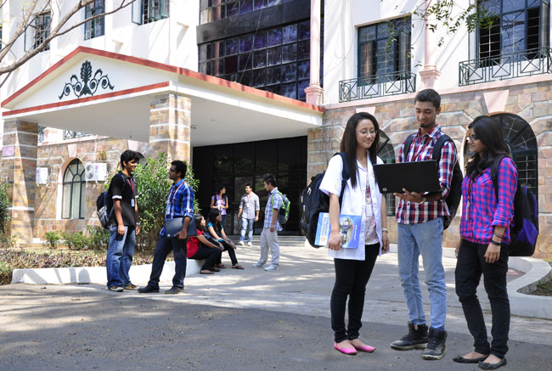

CSB4301 – Theory of Computation
B.Tech – IVth Semester
Mr. D.S.John Deva Prasanna AP(SG)
Department of Computer Science and Engineering

Slide 2
We Welcome you all to the New Academic Year
Mr.D.S.John Deva Prasanna, AP(SG), CSE

Slide 3
What is “Theory of Computation”?
A section of computer science which deals with recognition of languages.
Recognition techniques of languages plays a greater role in the design of compilers
Compilers translate high level language (C/C++/Java/Python..) to low level machine readable languages.

Slide 4
Languages
The one which interfaces humans and computers

Slide 5
What are the components of a language
Alphabet -
Words -
Sentences -
The user enters the program .... We have to verify whether the above three components are correct in the program.

Slide 6
Alphabet
Set of Symbols in a language
Examples
{α,β,γ,δ,..Ω}
{ a,b,c,..z}
{0,1,2,..9}
{+,*,-,/,--,++}

Slide 7
Words/ .....................”Strings”
A string is a finite sequence of symbols in a alphabet.
Consider the alphabet {a,b,c..z}
Example
Sun
earth
foon
The above are strings earth and foon are valid strings but Sun is not, do you know why?

Slide 8
Answer
BUT BELOW IS NOT A STRING OF ALPHABET {a,b,c..z}
Sun --- Because ‘S’ is not a part of the alphabet.

Slide 9
Sentences / Statement
One or more valid strings put together will form a sentence
Example
“sun rises in the east”

Slide 10
What does this subject concentrate on?
Mostly on Specification and Recognition of languages.
What is the difference ????
Specification - deals with techniques by which you can represent a language like an expression
Example
L = {1,4,9,16..} here L is a language which represents set of squares and be specified as x²

Slide 11
Recognition of Languages
Sometime we will be given with a string or a sentence and we need verify whether the given string or sentence belongs to the language.
Example
L={1,4,9,16,25,...}
Check whether the item ‘81’ belongs to the language ‘L’.
The answer is YES

Slide 12
Techniques for Specification and Recognition
 | Specification | Recognition
Alphabet | Any set of symbols can be an alphabet
Strings | Regular Expressions | Finite Automata
Sentences | Context Free Grammar | Push Down Automata /Turing Machine

Slide 13
Thank You

Slide 14
Thank You

